Slide 1

Encryption Tools
Comparison of tools and use case

Slide 2

Contents
Encryption tools and uses cases
OpenVPN vs Tor
1
How it works
2
Encryption tools
3
Use Case
4
Conclusion

Slide 3
Overview
Encryption methodology
Encryption tools offer privacy and depending on implementation anonymity too. They use heavy asymmetric-key encryption schema to pass a symmetric key for normal data (key-exchange) communication and this is authorized and approved via Certificates an online digital signature. With Symmetric encryption they establish an encrypted tunnel for data traverse
Encryption tools
OpenVPN
Tor
Use Case
Privacy
Anonymity
Decentralization
Free public speech

Slide 4
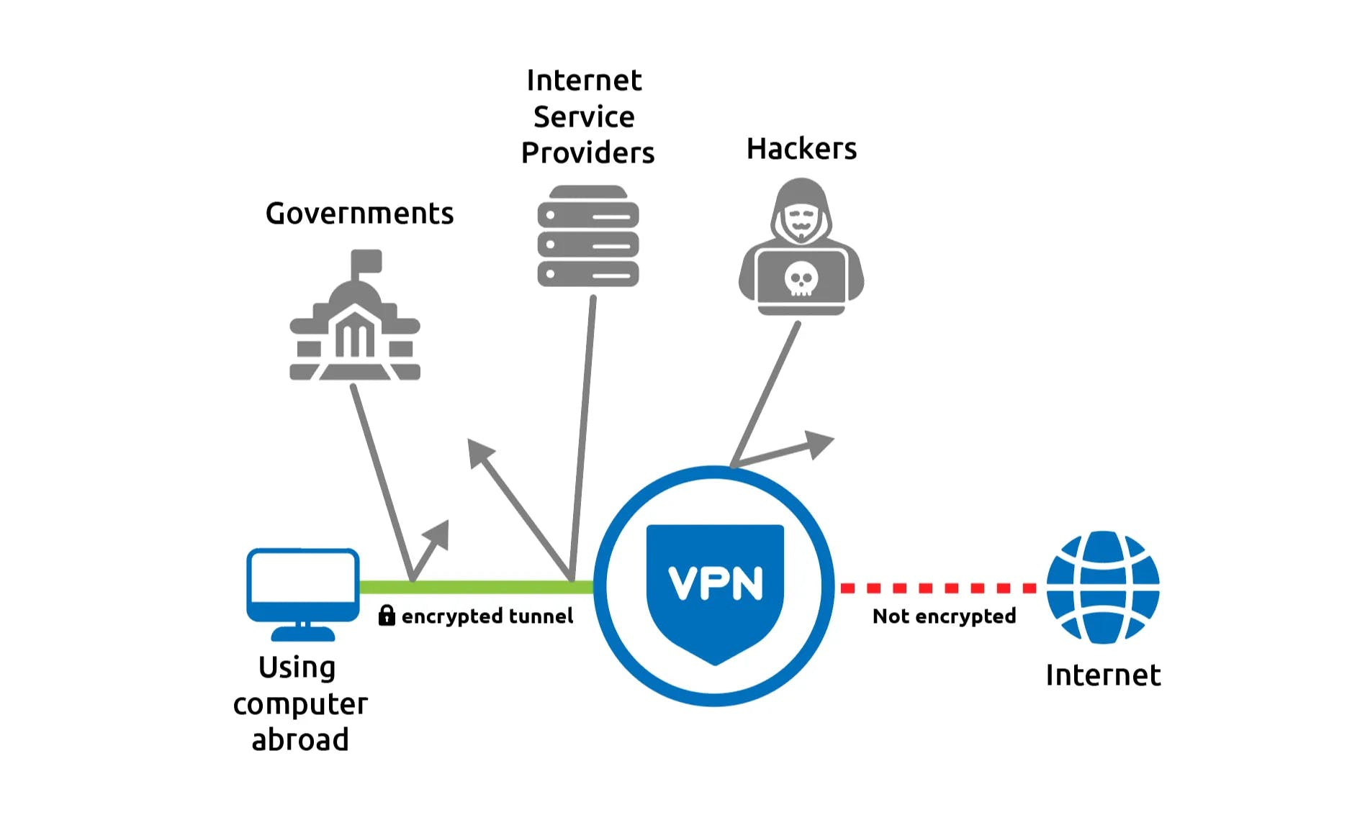
VPN

Slide 5
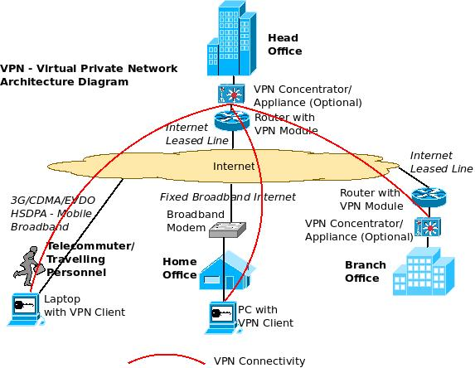
Extranet VPN

Slide 6
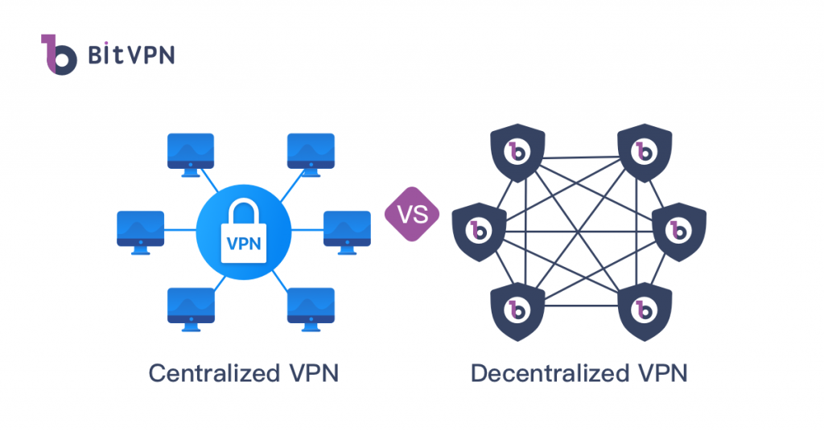
Centralized vs Decentralized VPN

Slide 7
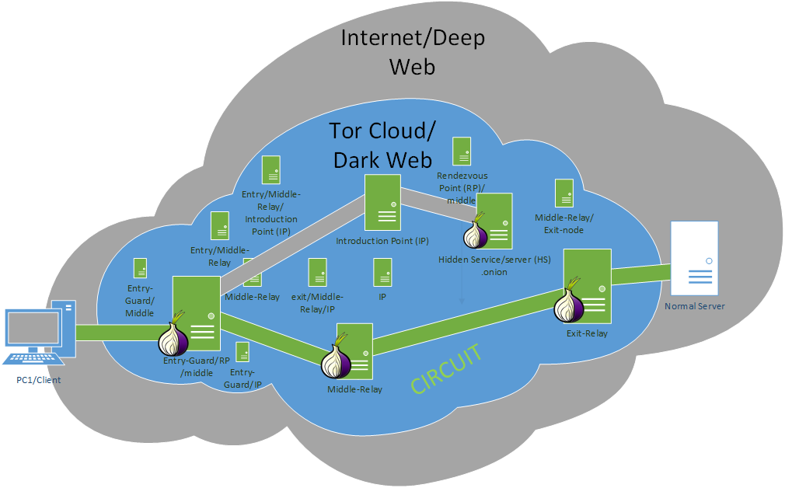
Tor

Slide 8
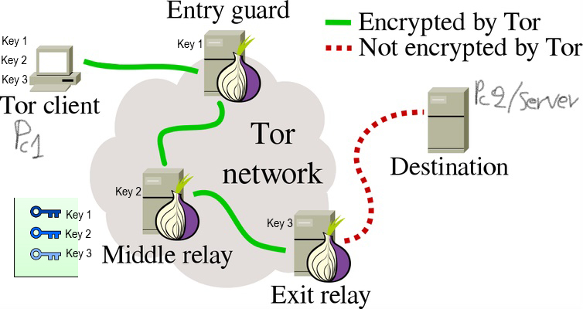
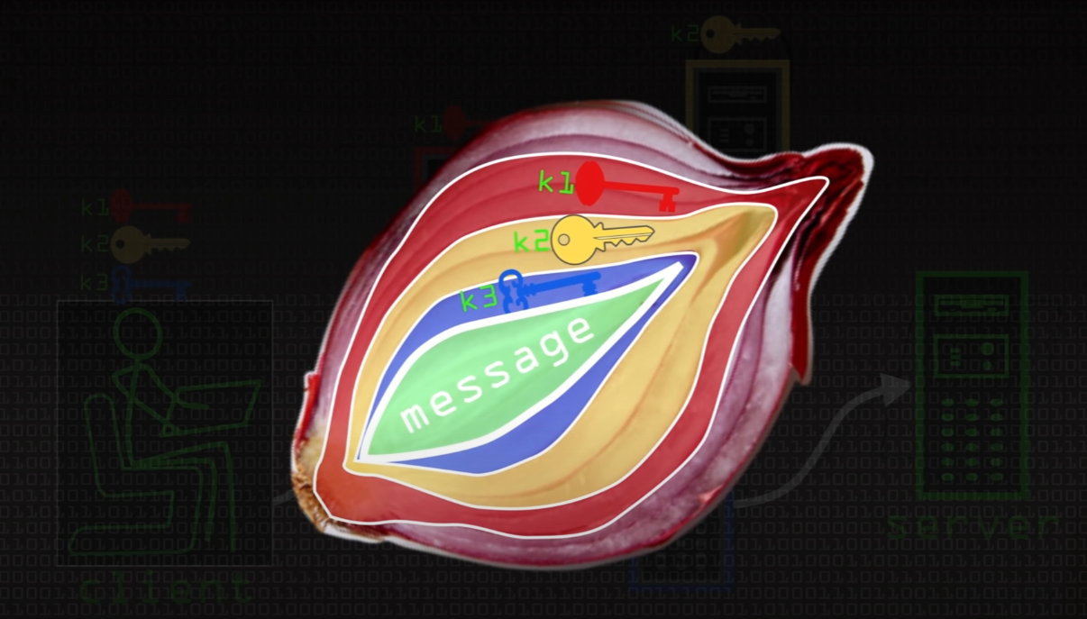
Tor

Slide 9
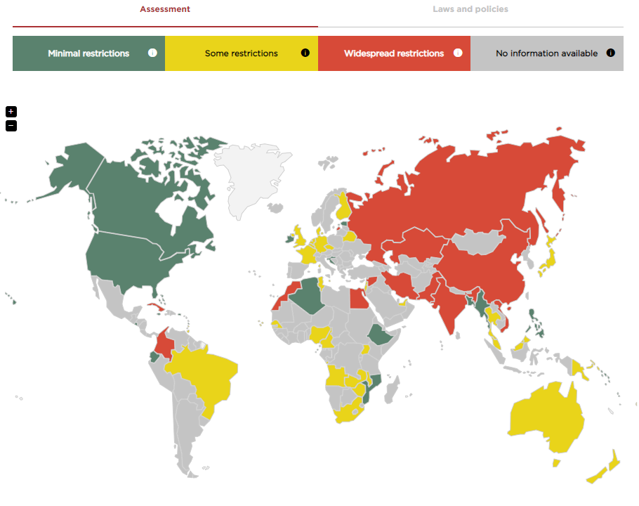
Law issues with encryption

Slide 10
OpenVPN vs Tor
Criteria | dVPN (possible OpenVPN in future?) | OpenVPN | Tor
Open-Source | + | + | +
Fast Speed | +, - | + , - | -
Easy to Setup | + , - | - | +
Easy to Learn | + , - | - | +
Network Interfaces | + | + | -
Scalability | + | + | + , -
Anonymization | + | - | +
Encrypted connections | + | + | +
Packet encapsulation Encryption | + | + | +
Data payload Encryption | + (any service is behaving like “using” “HTTPS” due to blockchain nature) [63] [64] | yes, if the target service is on site | -
Protects all online connections | +, - (e.g., site-to-site or host-to-host) | + , - | -
Ensures privacy | + | + , - | +
End-to-end encryption (E2EE) | + | Only for site-to-site and target service to be inside on target site | -
Decentralized peer-to-peer nodes | + | - | +
Flexibility on Business Network Ecosystem | + | + | -
Business Support (if can be applicable) | + | + | + , -
End-user support | + | + | +
Hard to trace | + | + , - | +
User-friendly | + , - | + , - | +
Unlock streaming content | + | + | Yes, but not usable due to its speed
Deep web | + | + | +
Dark web (hidden services) | +, - | - | ++
Roaming (not from mobile RAN ISP perspective) | ? (Depends on implementation) | - | -
Easy to choose exit node | + | + | -
Industry Standard | + | + | +
No Audit/Log Centralized | + | - | +
Product & Community Support | + , - | + | +
Cost/Pricing | Pay as you go | Free or subscription | Free

Slide 11

OpenVPN vs Tor
It is not about the percentage. It is all about use case and infrastructure
Open-Source
Anonymity
Open-Source
Decentralized
Fast speed
Hidden services
Privacy
Centralized

Slide 12
Use cases
Privacy
Anonymity
illegal activity
Home Users
ISP’s
Corporates
And many much more

Slide 13
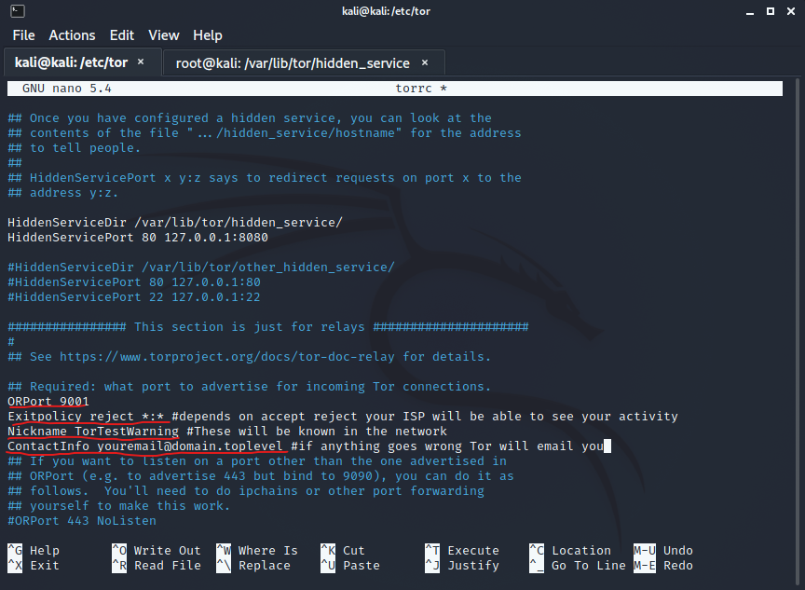
Use cases scenario
Tor Relay configuration example

Slide 14
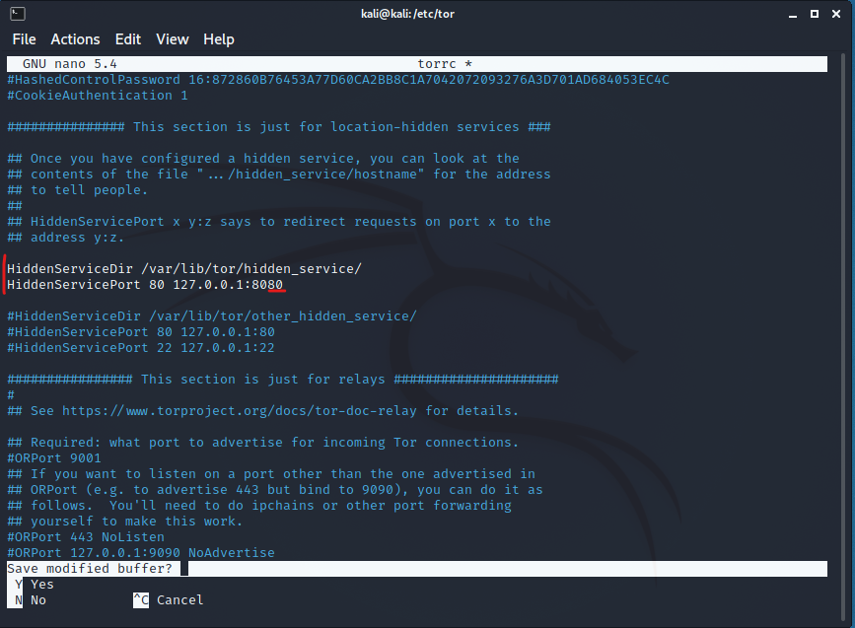
Use cases scenario
Tor Hidden Service Setup

Slide 15
Use cases scenario
Tor Hidden Service
As name suggests you create a Hidden Service
the actual application service such as HTTP website is being made on another server e.g., Python or TomCat or Apache

Slide 16
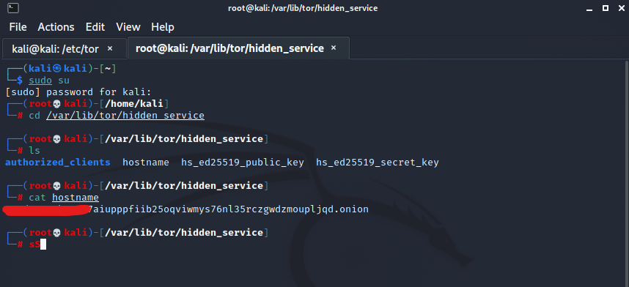
Use cases scenario
Tor Hidden Service URL

Slide 17
Conclusion
To Use a tool
Its about current infrastructure and design possibilities
To solve a problem
There is no perfect solution everything can satisfy someone and dissatisfy someone else. Every tool has its usages in the right spot and under a provisioned network designed strategically. Is about what a client or/and stakeholder wants in a project. They could work as a complementary solution to each other to enhance security even more.
While regular VPN offer protection to their users (for a price), the real fight against surveillance and censorship is a shared one because the current providers do nothing to address the infrastructural flaws of the internet so there is no immunity to corporate or government control.
There is not a single fit-all-size solution or a true security mechanism that protects you from a data breach, every method is just an additive layer of security that could be stripped from an attack.
Anecdotally the more complex layer of the OSI model is Layer 8 user/political layer because technology is human-driven or an echo of our lives and security is totally something that we want but always in our advantages, not someone’s else that carries everywhere from “our” to a single human or organization (everything must be secure but not secure in the same time)

Slide 18
Thank You!

